Slide 1
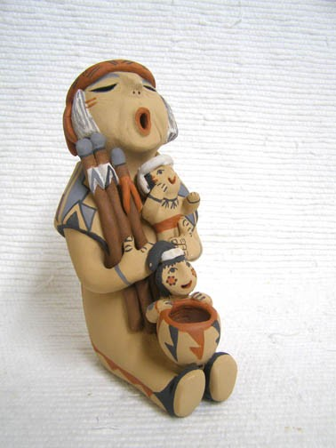
Storytelling and Wisdom
Annabelle Nelson, Ph.D. Professor Fielding Graduate University
anelson@fielding.edu

Slide 2
Joseph Campbell: The Hero with a Thousand Faces
…..myth is the secret
opening through which
the inexhaustible
energies of the cosmos
pour into human cultural
manifestations… pg. 1

Slide 3
Early Memory of an Story Stories Plant symbols in the mind that grow over time… (Terry Tafoya)
Early Memory
Think back, think back, when someone was telling or reading you a story, an experience you really liked, where were you, who was with you, any noticeable perceptual details?
Which character did you like, which character captured your imagination? Any color you associate with the color, and noticeable characteristics?

Slide 4
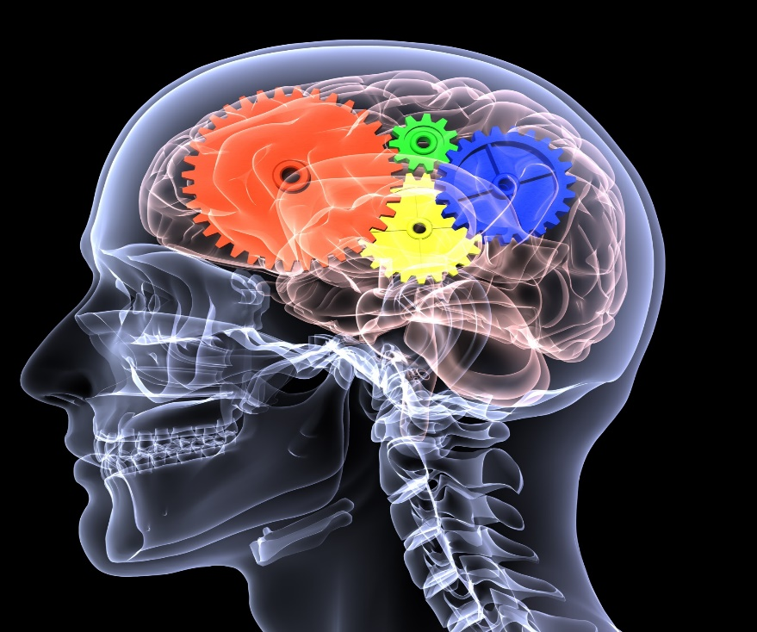
Wisdom: liveability (Thomas Aquinas) Knowledge transformed with compassion (Chögyam Trungpa)

Slide 5
Wisdom…..going beyond & through
“Wisdom is a function of deep insight into, and mature understanding of, the central existential issues of life, together with practical skill in responding to these issues in ways that enhance the deep wellbeing.” Walsh, 2011, Pg 110
Wisdom is… emotionally mature, spiritual, creative, paradoxical, inter-individual
Jerome Kagan- inter-individual stage
Erik Erikson- generativity

Slide 6
Stories Carry Wisdom
“Stories present deep insights into the affective dimension of human learning, socialization in community, and the role of story in the transfer of cultural knowledge and values. The deep psychological mechanisms associated with myths, stories, and storytelling facilitate the development of not only self-knowledge but also social and communal knowledge on the part of children. Story is one of the most basic ways that the human brain structures and relates human experience. Everything that humans do and experience revolves around some kind of story.”
Pg. 114, Cajete, 2017

Slide 7
Stories impart Transformation (Nancy Mellon)
Character Transformation
Passivity | hope
Sloth | industry
Loneliness | oneness
Stubbornness | kindness
Impatience | forbearance
Illness | health
Handicap | gift
Poverty | wealth/contentment
Awkwardness | grace
Rage | attention
vanity/pride | understanding
Hyperactivity | calm
Powerlessness | potency

Slide 8
Storytelling The Wisdom Method Transformation of the Mind
Stories evoke vivid images in the mind, of the character archetypes
Stories have emotional valence
Stories evoke internal sensory memories of smells, sites, colors
As a result awareness connects to the limbic system of the brain that expands perception.
An open mind sharpens perception and allows insight to flourish.

Slide 9
How Do Stories work?
A story is oral account
Cultural stories are ancient human technology to…
1. The coherence in one’s life from the past and the hope in one’s life for the
future.
2. The awareness that adversity will come in life.
3. The ability to laugh at pitfalls
4. Beliefs.
5. How to stay safe.
6. Identification with a group or tribe.
7.Positive character traits
8. How to withstand negative forces and to overcome adversity.
9. Acceptance of one’s role or destiny in life.

Slide 10
Storytelling
Humans are natural storytellers to communicate and make sense of their lives.
Stories move humans into liminal spaces tapping into the collective unconscious of human patterns.

Slide 11
Liminal Realm: Liminal is a Threshold, Going Beyond & Through
Teaching an inner focus over times helps establish ego integrity by allowing emotional material to clear
Clear and open the mind to the connection to the deep Self, creative force, collective unconscious

Slide 12
Epistemological Assumptions
There is a creative force in the unconscious that can lead humans to emotional healing and growth.
The language of the unconscious is metaphoric and imagistic.
Opening the unconscious open in a safe manner, releasing emotional material: release emotions & receive insights from intuition
Stories contain human wisdom and the characters and symbols can resonate in the individual unconscious to activate the creative force.

Slide 13
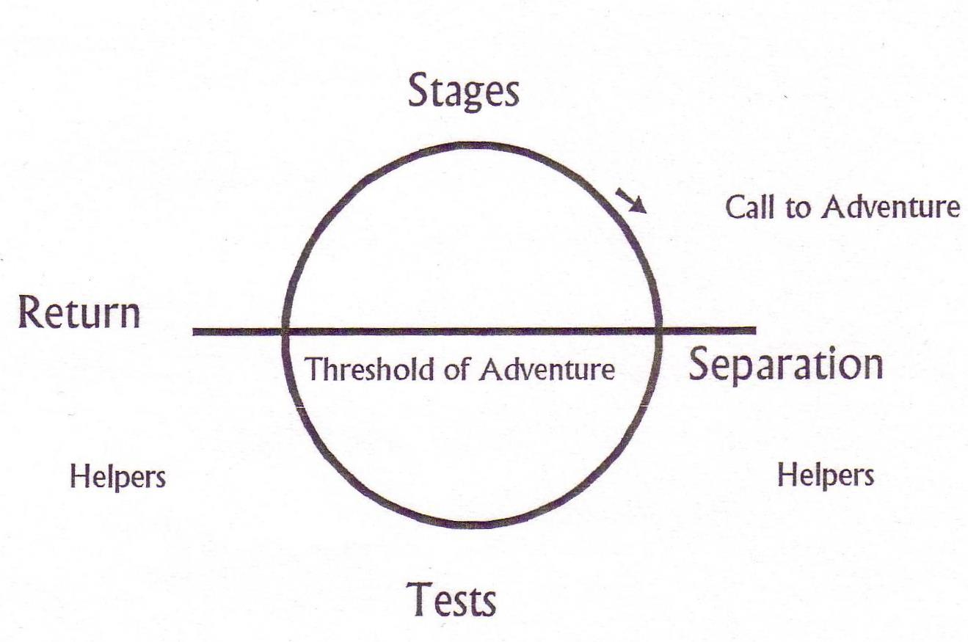
Storytelling Cycle: The Stages

Slide 14
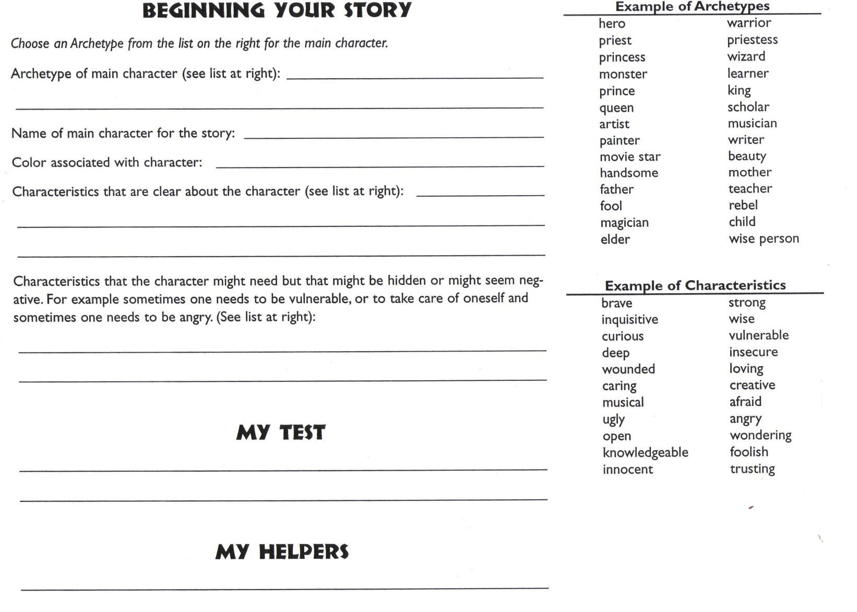
Tests & Storytelling

Slide 15
Tell your story

Slide 16
Summing up & Close
What to take away?

Slide 17
references
Cajete, G.A. (1994). Look to the mountain: an ecology of indigenous education. Skyland, NC: Kivaki Press
Campbell, J. (1972). The hero with a thousand faces. Princeton, New Jersey: Princeton University Press.
Houston, J. (2000). Myths of the future. The Humanistic Psychologist. 28 (1-3), 43-58.
Mellon, N. (1992). Storytelling and the art of imagination. Rockport, MA: Element, Inc.
Nelson, A. (2014). Archetypal imagery and the spiritual self: Techniques for coaches and therapists. Jessica Kingley.
Nelson, A. (2007).The spacious mind: using archetypes for transformation towards Wisdom. The Humanistic Psychologist.35, 235-246.
Tafoya, T. (1982). Coyote’s eyes: Native cognition styles. Journal of
American Indian Education, 11, 21–33.
Trungpa, Chöygam. (2010) The heart of the Buddha. Shambhala.
Von Franz, M.-L. (1996). The interpretation of fairy tales. Boston: Shambhala.
Walsh, R. (2011). The varieties of wisdom: contemplative, cross-cultural and integral contributions. Research in Human Development. 8(2). 109-127..
c

