Slide 1

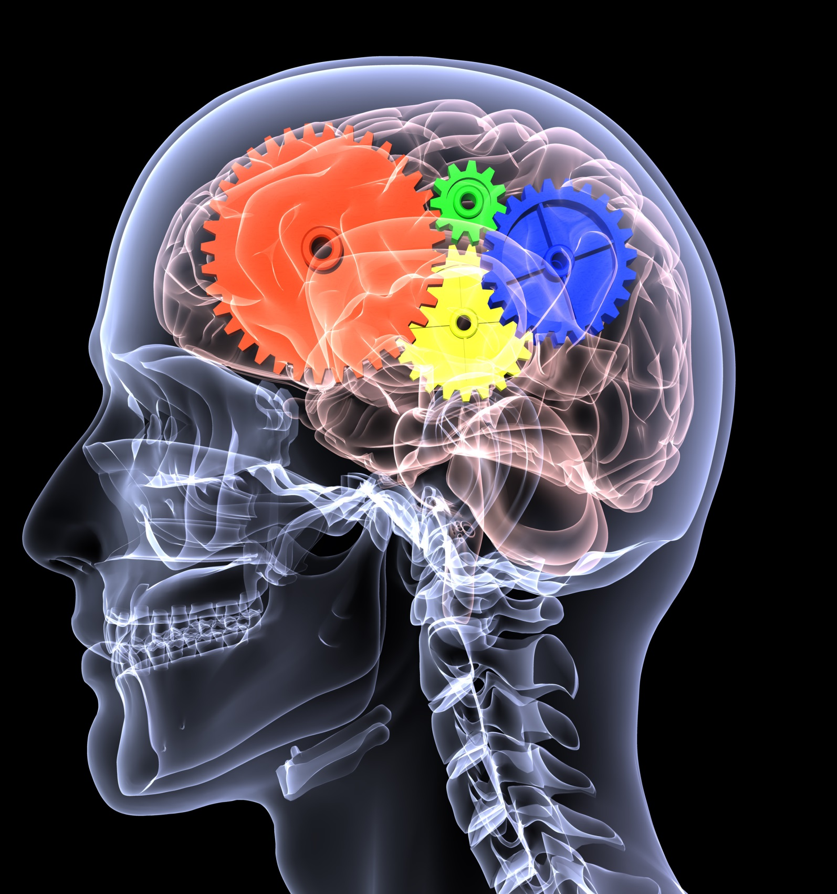

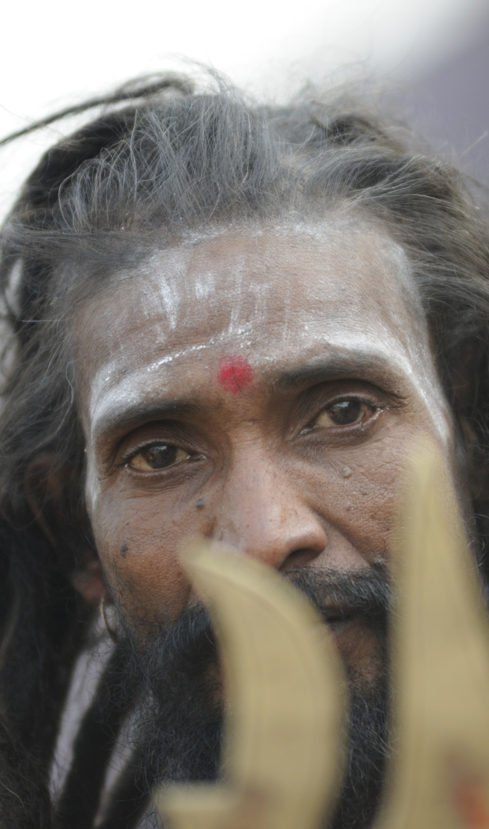



Wisdom
Wisdom is a function of deep insight into, and mature understanding of, the central existential issues of life, together with practical skill in responding to these issues in ways that enhance the deep wellbeing (Walsh 110).

Slide 2


Archetypal
Identification: Patterns of Wellness and Wisdom
Myths, Archetypes & Symbols
27-28 Sep, 2025, Birkbeck, University of London
Annabelle Nelson, PhD Professor
Fielding Graduate University, USA
Human and Organizational Development
Nelson, A. L. (2024).The heroine archetype Heroism Science: Vol. 9: Iss. 1, Article 9
Nelson, A. (2014). Archetypal imagery and the spiritual self. (2014) Singing Dragon
A special thanks to Dr. Chuk-Yim Stephen Chiang and his gift to the Rosenthal-Nelson-Appelbaum Fund and to Research Assistants Suji Venkataraman & Steven Bond

Slide 3

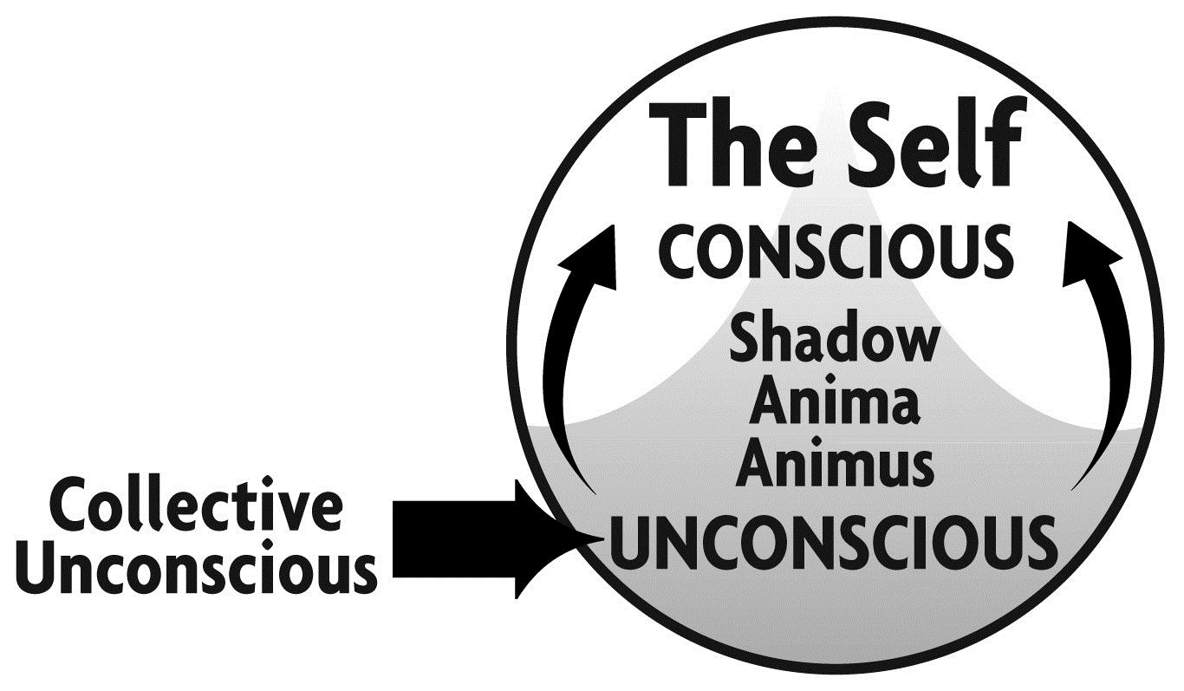
Finding the Self: Wellness for the Self and Community transforming consciousness to spaciousness (awareness of the Self) creates a state of wellness & Wisdom that emanates to Others

Slide 4

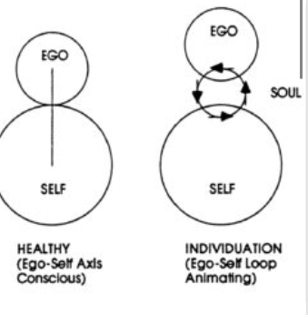
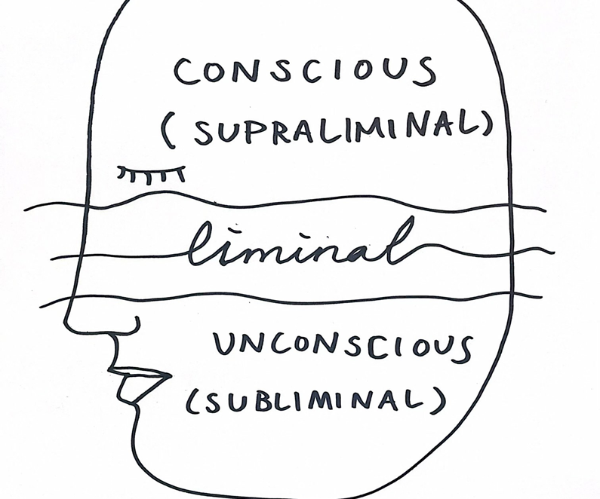
Ego-Self axis, archetype allows the flow between conscious and unconscious, access to full potential (Edinger, Ego & Archetype)

Slide 5
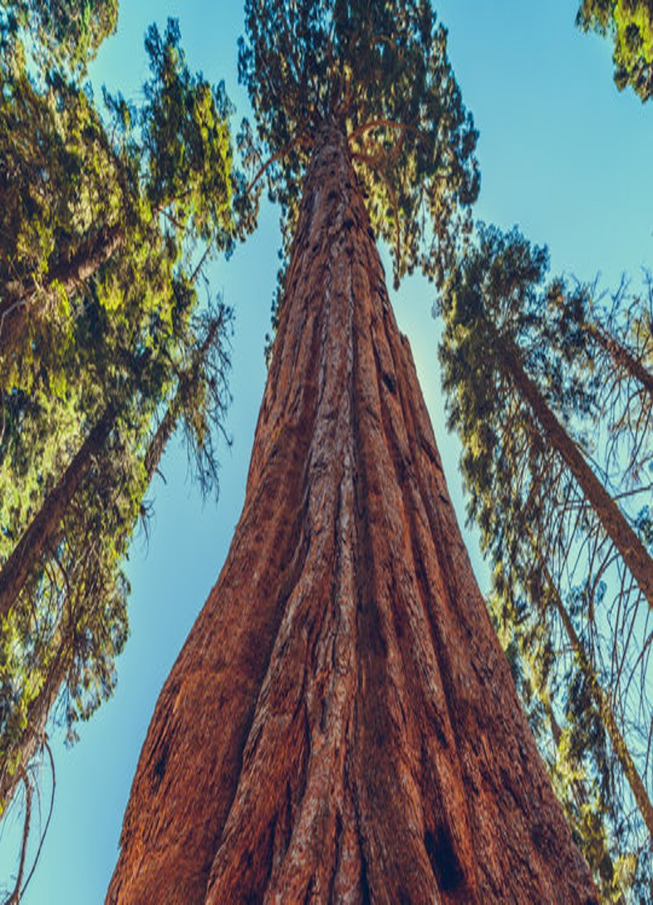
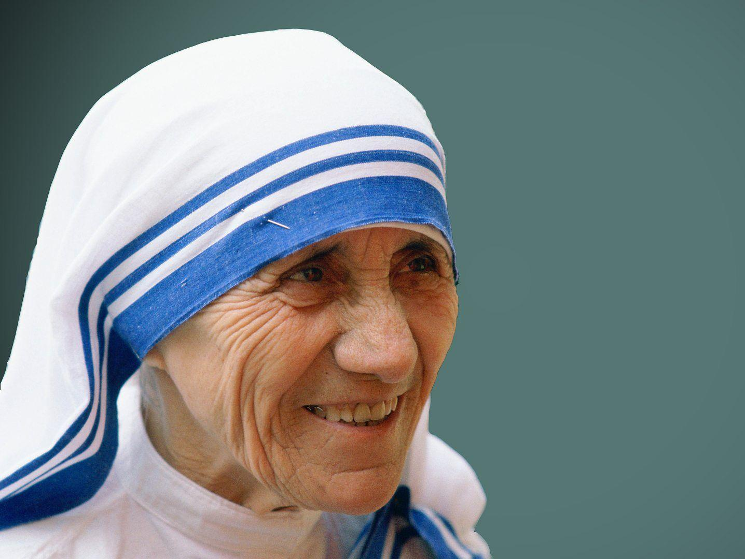
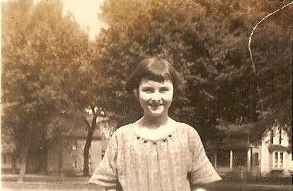

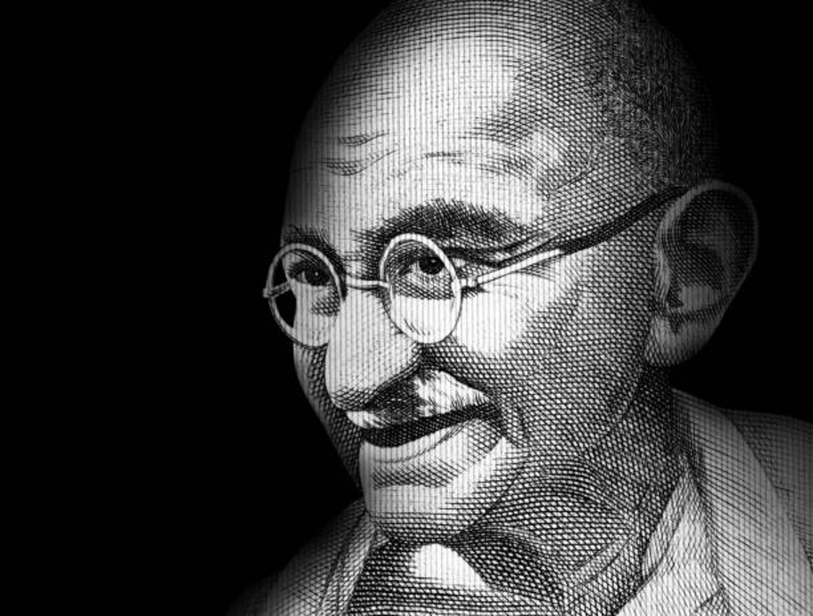
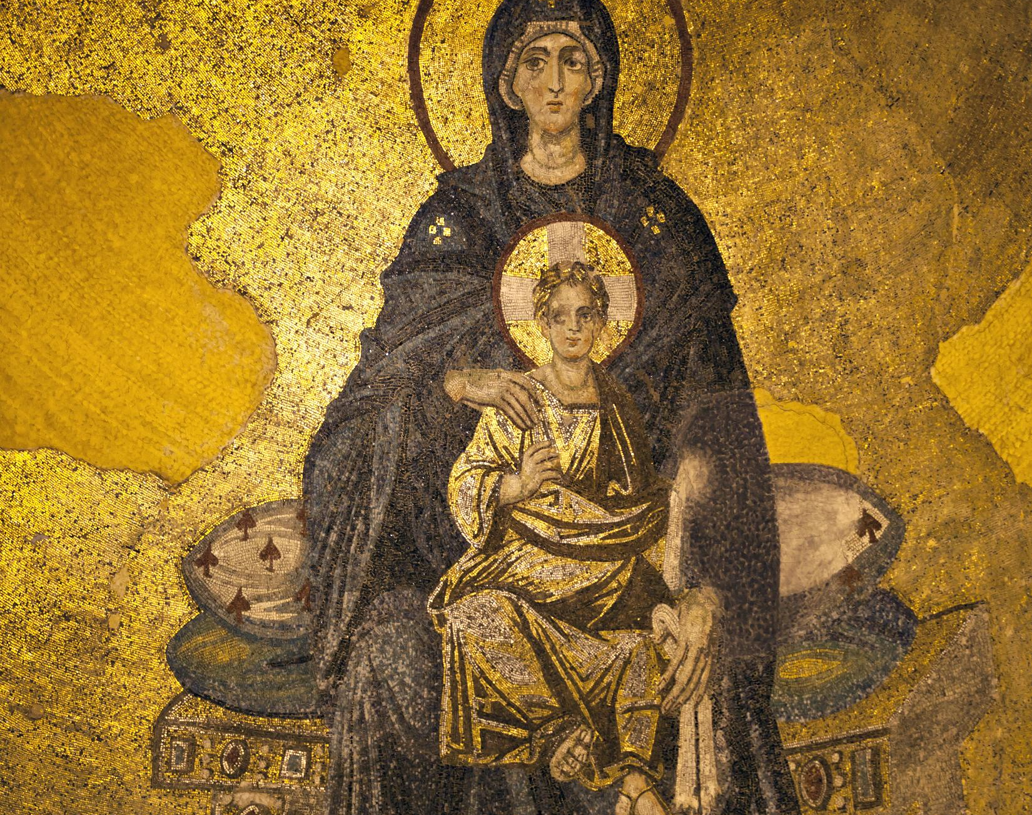
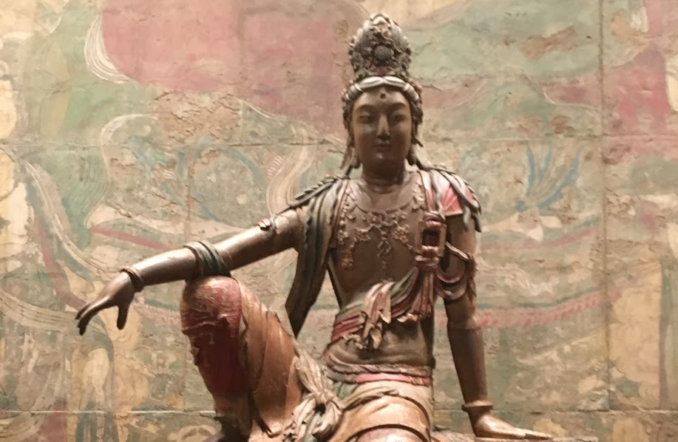

Slide 6
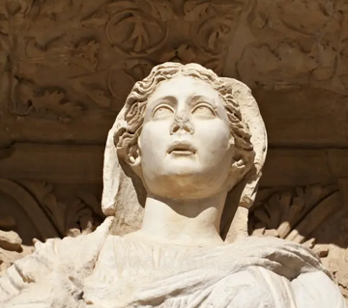
Archetypes
An Archetype is an energy pattern in the collective unconscious that conveys a given characteristic. Children unconsciously choose one to organize their personality.
Consciously aligning with an archetype gives power to open the Self and allow insights from the collective unconscious.

Slide 7
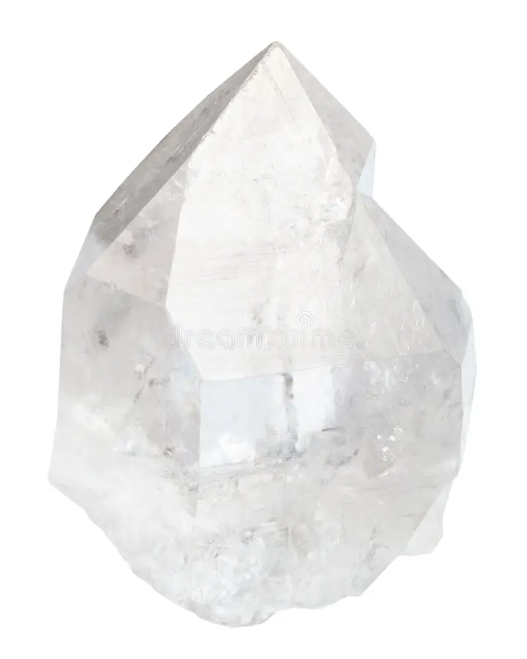
Archetype identification activates a natural psychodynamic,
Adults can consciously choose one. Every Archetype contains Every other one (Marie-Louise von Franz). Archetypes are like the Facets on a prism. The Energy pattern opens the unconscious safely to the personal and collection unconscious.
Notes:
But we want human happiness as humans too

Slide 8

Archetypal Identification
Amplifies characteristics
Transforms consciousness
Archetypal Visualization taps the benefits of imagery, opening memory banks, expanding perception, tapping emotions and relaxation response
Notes:
Spiritual awakening, me & Lilias

Slide 9

Archetypal Wellness Workshop
70- minute zoom meeting: dyad work multisensory imagery activities, accompanied by meditation music.
-Dyad, think back to your childhood favorite character, book, TV show, movie, person
-Imagery, a favorite outside spot, you are feeling okay, an entity comes to you, let the scene move, debrief first with drawing, then sharing
-Imagery, a recent scene that engendered a feeling that you didn’t like, that didn’t feel good, see it in present time like a movie, find a spot in the body where you feel the most, visualize the feeling
-Imagery, bring your archetype into the scene, let the scene move, debrief first with drawing then sharing

Slide 10
Data Collection (Qualtrics)
Pre: adapted Personal Assessment: Dimensions of Wellness, University of Colorado, (Emotional, Spiritual, Physical, Social, Occupational, Intellectual, Environmental). Likert and short answers. Example: I feel good about myself and believe others like me for who I am.
Post: Qualitative answers by the participants on the workshop experience and interaction with archetypes.
Follow-up: Qualitative answers on use of archetypes & Personal Assessment: Dimensions of Wellness

Slide 11
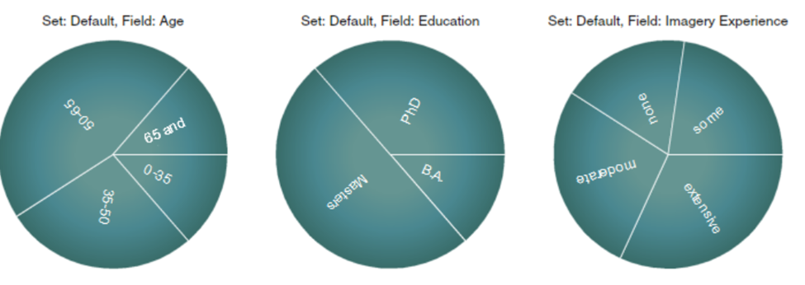
Participants,
22 from purposive sampling

Slide 12
Theme 1: Archetypes were easy to visualize
I didn’t realize that I had an archetype at all, let alone that it would be a source of inspiration and motivation. (937)
List of Archetypes Created by Participants: Muir Woods, Native American elder, Goofy, Barbie, Purple cloud-shape, feminine divine, floating being of white light, human form that sparkles, Viking, Batman, women riding a horse, butterfly, a brown hand, lion, Nordic forest deity, mermaid, rock band leader, Kuan Yin, jungle beach tree, wonder woman, hummingbird, father, coyote

Slide 13
Themes 2: Awareness was enhanced
Calmness and peace
Openness to possibilities
Self- Empowerment
Refinement of Purpose
Keep focusing on the here and now, what’s right before me (323).
Remain calm and focused while we prepare for the unknown (170).
My awareness became clear that perhaps by silencing myself, I may be doing more harm or causing more stress (480)
My purpose and awareness that I was chosen to keep the family together (499).
I have a deeper awareness of the influence that I can bring to the outcomes of my situation (170).
I was able to see more possibilities about how to deal with the situation going forward, I might bring the idea in - it is now an option (711).
Brought me a sense of calm, allowing me to relax and trust that all is well (279).

Slide 14
Theme 3: Interaction with archetype transmuted emotions
My Elder transmuted the painful emotion to one of well-being, and the color changed back to a vibrant orange color. I have increased awareness of my own well-being and forces that support my well-being. I will more likely work with my Elder to support my well-being in situations here I might experience lack or fear (229).
When I saw the Native American /Indian I felt peace/calmness (937).
The emotions subsided and completely evaporated. I felt calm and collected. Even protected (271).
I fill my life with the joy of people and experiences, or I can wallow in grief (521).

Slide 15
Theme 4: Archetypes were called on for stress and in difficult or messy situations (after 30 days)
I might summon my archetype when I feel stressed (247).
I certainly can see using this as a practice in the future to help me move from a difficult situation to one of more calm and perspective (785).
I can harness this image of embodying the archetype and expand beyond the fear the next time I am in a triggered state (266).

Slide 16
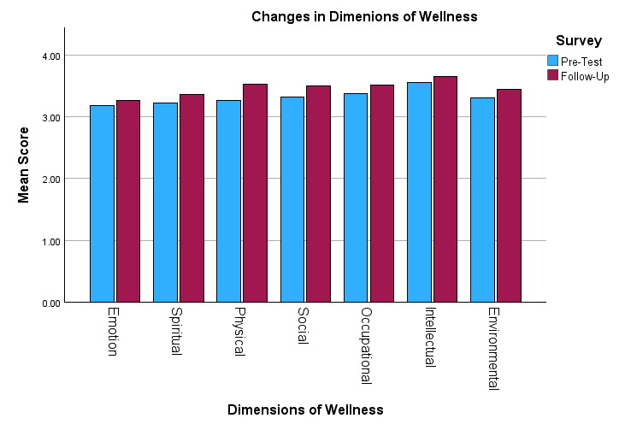
Paired Samples Correlations
 |  | N | Correlation | Significance
 |  |  |  | One-Sided p | Two-Sided p
Pair 2 | Pre_Spiritual & FU_Spiritual | 19 | .682 | <.001 | .001
Pair 6 | Pre_Intellectual & FU_Intellectual | 19 | .575 | .005 | .010
Spiritual Ex.:I take time to think about what is important in life - who I am, what I value, where I fit in, where I'm going.
Intellectual Ex: I am open to new ideas.

Slide 17
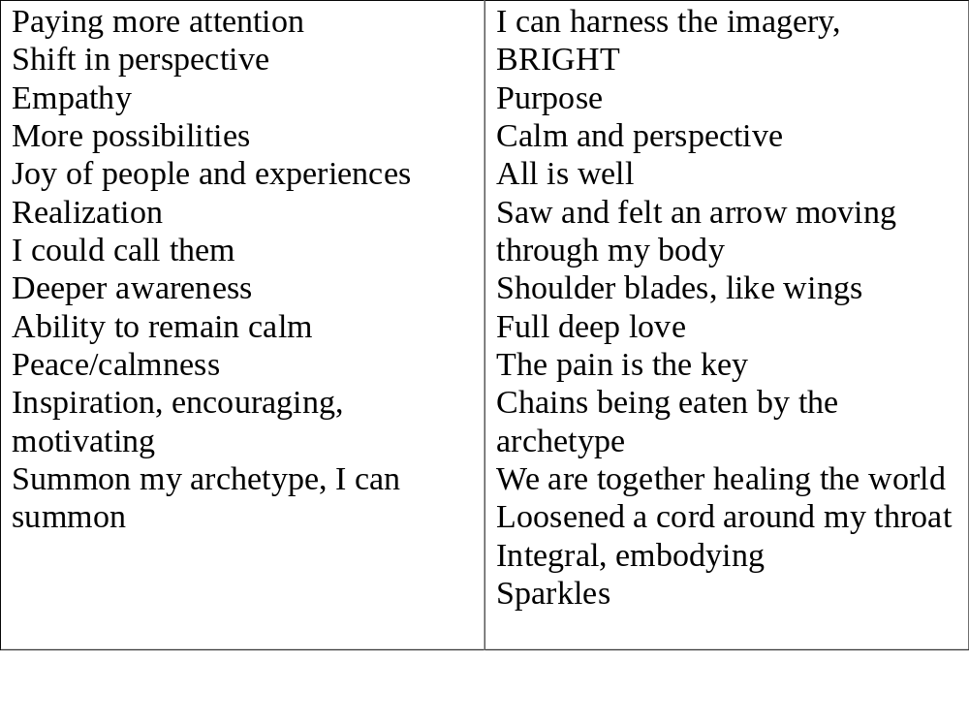
Found Poety of Participants’ Words

Slide 18
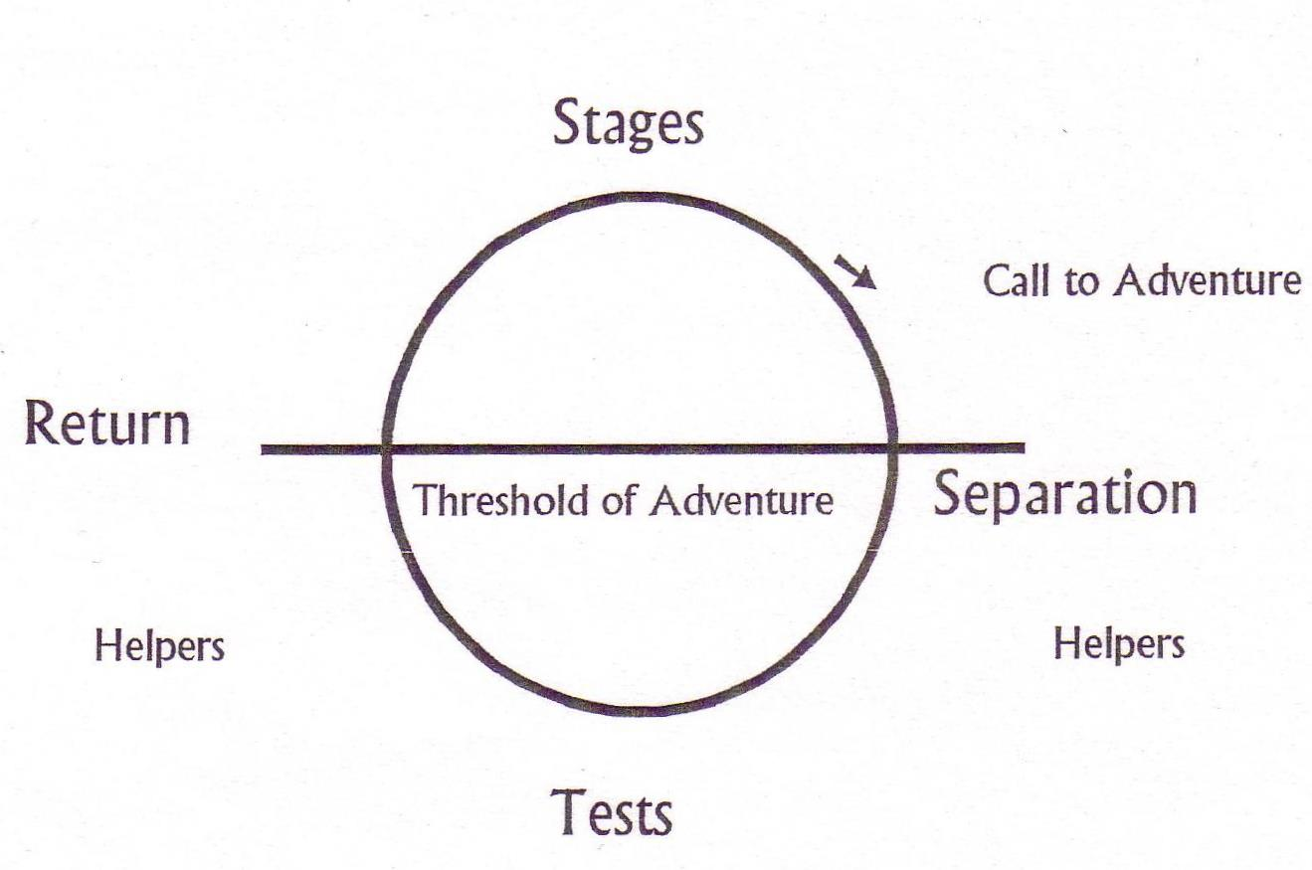
Trite, but powerful.
What if daily life is the call to adventure?
Buddha’s First Noble Truth: duhkka, suffering or dissatisfaction with life. Tests abound in life.
What if the Hero/Heroine journey is to face the tests of life to transform. The archetypes is the helper to transform for the return. “the adventurer must return with his life-transmuting trophy.” (Campbell pg. 196)
The Hero/Heroine Journey
The focus: tests & helpers

Slide 19
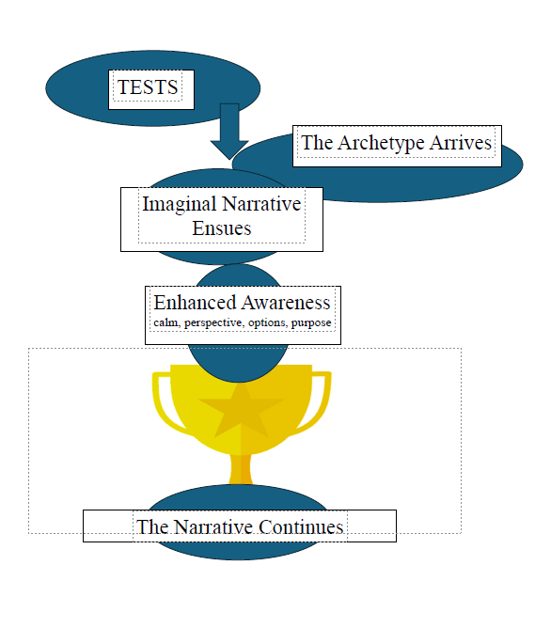
Archetypal
Wellness
Notes:
`

Slide 20
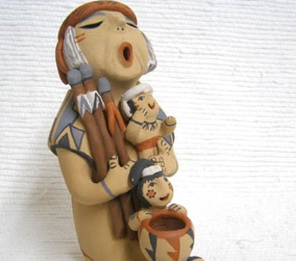
Thank you! Let’s keep telling our stories
Annabelle Nelson, PhD anelson@fielding.edu https://annabellenelson.com/graduate-students/

Slide 21
Bibliography
Edinger, E.F. (2017). Ego and archetype. Shambhala Publications.
Campbell, J. (2008). The hero with a thousand faces (Vol. 17). New World Library.
Fleischer, K. (2023). Collective trauma, implicit memories, the body, and active
imagination in Jungian analysis . Journal of Analytical Psychology, 68(2), 395-415.
Nelson, A. L. (2024). The Heroine Archetype. Heroism Science, 9(1), 9.
Nelson, A. (2014). Archetypal imagery and the spiritual self: Techniques for coaches and
therapists. Singing Dragon.
Ravitz, L. J. (2022). The valiant battle: from chaos to integration. Journal of Analytical
Psychology, 67(4), 1091-1125. https://doi.org/10.1111/1468-5922.12856
Steel, C., Wright, K., Goodwin, G. M., Simon, J., Morant, N., Taylor, R. S., ... & Holmes, E. A. (2023)The IBER study: a feasibility randomised controlled trial of imagery based
emotion regulation for the treatment of anxiety in bipolar disorder. International Journal
of Bipolar Disorders, 11(1), 27.
Von Franz, M. L. (2021). Volume 1 of the Collected Works of Marie-Louise von Franz: Archetypal
Symbols in Fairytales: The Profane and Magical Worlds. Chiron Publications.
Walsh, R. (2011) The varieties of wisdom: Contemplative, cross-cultural and integral
contributions" Research in Human Development, 8.2, 2011, 109–127.
Zaleskiewicz, T., Traczyk, J., & Sobkow, A. (2023). Decision making and mental imagery: A
conceptual synthesis and new research directions. Journal of Cognitive Psychology,
35(5), 603-633.

