Slide 1
Qualitative Data Analysis

Slide 2

Notes:
What if life were sweet. Wisdom is catching, each have a piece, figuratively open our eyes of the blind mind to see the whole picturepg 180

Slide 3
Josselson
Human life is composed of stories. Narratives construct memory, organize time, and create identity (Ricoeur, 1981; MacIntyre, 2007); stories integrate facts and feelings (Fulford, 1999). Narratives are the only means by which people can communicate what goes on inside them and what links them to others. Personal narratives are “the most internally consistent interpretation of presently understood past, experience past and anticipated future.” (Cohler, 1982, p.207).”
Josselson, R. (2013). Interviewing for qualitative inquiry. NewYork: The Guilford Press.

Slide 4
Nelson et al
“Narrative research studies the whole person in context and examines whole lives. Stories convey information in a present time sense and include a felt sense, giving new perspectives and clarity to understanding experiences. The patterns of these experiences become apparent. Storytelling taps unconscious emotional material and memories that contain salient content about an event(Nelson et al, 2008, pg. 128).”
Nelson, A., McClintock, C., Nash Shawver, M., Perez-Ferguson, A. &
Thompson, G. (2008). Storytelling narratives: social bonding as key for youth at risk. Child and Youth Care Form, 37, 127-137

Slide 5
Validity & Reliability
Quantitative & Qualitative Reliability & Validity
 | Quant Looking for patterns are generalizable | Qual Looking for patterns from rich description of a given phenomenon
Reliability Consistency Repeatability Dependability Stability | Repeated administration Cronbach alpha on items | Inter rater reliability on coding Member check Dialogue across researchers (Grounded Theory)
Content Validity Correct Accurate True Confidence Credible | Correlation with 2nd measure | Triangulation Themes match participants’ words Interview questions match research question
Construct Validity | Research Concept=items Research Concept=measures | Research Concept=interview topics

Slide 6
Research Method | Privileged Way of Knowing | Data Collection | Data Analysis By Method
Open ended qualitative | Life in context | Qualitative Interviews | Content Analysis
Narrative | Voice |  | Content Analysis
Phenomenology | Experience |  | Content Analysis
Heuristic | Interaction |  | Composite Story
PAR Participant Action Research | Participation |  | Content Analysis
Co-inquiry | Collaboration |  | Group Content Analysis
Grounded Theory | Openness |  | Content Analysis
Ethnography | Cultural context | Interviews Field Journals Artifacts | Content Analysis
Hermeneutic | Deep meaning of text | Interviews Texts | Content Analysis
Case Study | In-Depth | Interviews Artifacts Field Journals
Autoethnography | Personal memory | Journals Artifacts | Content Analysis

Slide 7
Types of Qualitative Data Analysis
Narrative Analysis
Narrative analysis can thus be used to connect microevents to broader discourses and contexts with the intent of asserting the construction of social experiences through narratives. Pg. 118
Patton, M. Q. (2002). Qualitative research & evaluation methods. Thousand Oaks, SAGE Publications
Thematic Analysis
Thematic analysis is a method for identifying, analyzing and reporting patterns (themes) within data. It minimally organizes and describes your data set in (rich)detail. A theme captures something important about the data in relation to the research question, and represents some level of patterned response or meaning within the data set. Pg. 70
Braun, V & Clarke, V. Using thematic analysis in Psychology. Qualitative Research in Psychology 2006; 3: 77_/101, pg. 70

Slide 8
Types of Qualitative Analysis
Constructivist Grounded Theory
For traditional grounded theorists, coding from the data is the fundamental analytic tool that will uncover an emergent grounded theory from the field of inquiry. Three forms of codes are used: open, theoretical, and constant comparative (Glaser, 1992). Open coding is the initial step of theoretical analysis, developing codes from the data. This form of coding ends when it locates a core category. Pg 29
Mills, J, Bonner, A, & Francis, K. The development of constructivist grounded theory. International, 2006 5(1), 25-35.

Slide 9
Types of Content Analysis
Lieblich, Tuval-Mashiach & Zilber’s Definition of Narrative Research Analysis
Holistic Content, look at the text as a whole to find themes
Holistic Form, look at plot analysis, patterns of progression, regression, steady line
Categorical Content, look at separate parts of the texts to find themes, this is what is often used in Fielding dissertations
Categorical Form, focus on a certain part of text related to research question and then do a plot analysis

Slide 10
Open Ended Interviewing:
Rich Description
Start with Warm up
Avoid theoretical, academic language (do not use research question)
“Think of a time….”
“Tell me about a time….”
Encourage perceptual details of memories.
Qualities of effective qualitative interviews
Rich description, Voice
Authenticity, Resonance
Interviewer stance
Bracket, practice, clarify role
Expect emotions, journal
Make it long enough
Is there anything to aDD

Slide 11
Research Question
The research question for this study is: What do heterosexual-identified individuals
who are or have been affiliated with evangelical Christianity describe as their journeys from
anti-gay to pro-gay?
Warm up example:
How would you describe your religious or spiritual identity? Christian, non-
Christian, or in another way?
Tell me about open ended question example:
Can you think of another time where you began to see that lesbian and gay people deserve
equal rights, just like everyone else? For example, the right to marry the person they love or
to adopt children?

Slide 12
Practical How-Tos in Content Categorical Analysis
Print transcripts
Read transcripts
Write down what you think is happening, any assumptions you have. Then consciously put those aside. This is called “bracketing”
Read through again.
Read thru and underline phrases, note topic of that stands for that phrase in margin, the topic should be specific enough to carry meaning. For example, “financial resources” is very general, but “borrowing money from family” is more descriptive.
Review what you have done, and see if you can drop out any topics, or rename them more meaningfully.
Create a word or excel file with the topic and the quotes (the phrases you underlined) underneath the topic which have now become the categories.

Slide 13
Practical How-Tos in Content Categorical Analysis cont’d
Look through and see if any topics can be combined, if so either use the best fit category you have and put all quotes under that category. Or create a new category that combines the previous topics that fits the categories you are combining.
The collated categories are now the themes. Create list of themes with the aligned quotes under them.
Some may be major themes and others might be minor. You can drop out minor ones. Think of working towards 10 major themes.
Review and see if you want to tweak them in any way.
Examine themes, you may be able to look at interrelationship and begin model building or relate them back to areas in the literature.

Slide 14
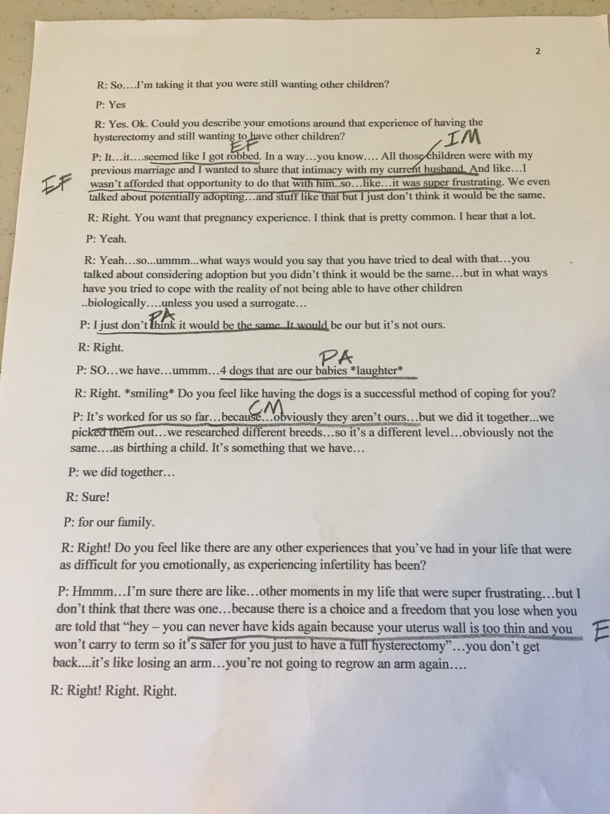
Example of Coding
Open Coding: Allow Codes to develop, read and Re-read underline salient units, note codes on the side.
Over time patterns repeat and codes can be combined, eventually these become themes.
A priori or code book
Codes are developed from literature or from a previous piece of research

Slide 15
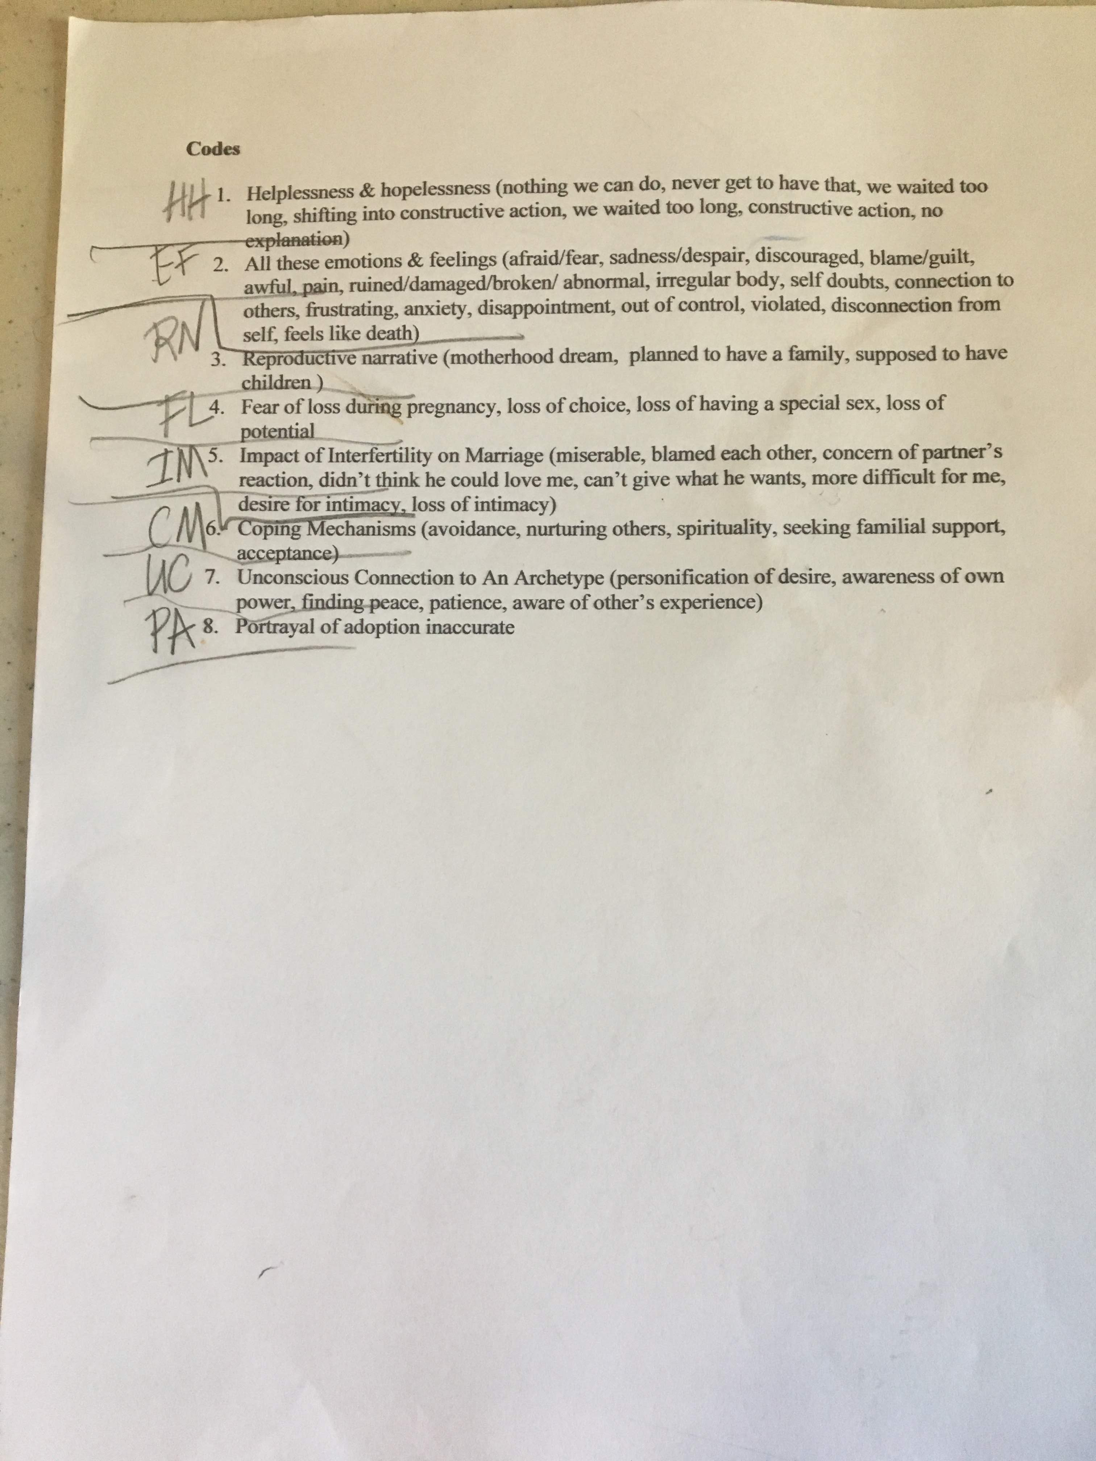

Slide 16
Example of Combining codes for Themes
Reliability
Create Code Book after open coding
Have 2nd Coder, Code 10% of Data independently
# of agreements/# of agreements + Disagreements

Slide 17
 | Major and minor themes | Number of participants
Major theme | Social media & smartphones create a perceived pressure to have sex | 13
Minor theme | Perceived pressure to have sex may influence young men to use drugs and alcohol to make it easier to have sexual encounters | 6
Minor theme | Sexual behavior and attitudes strongly influenced by peers and social media | 7
Major theme | Young men do not have experience in developing intimate relationships | 12
Major theme | Snapchat is the main way young men connect with a woman to have sex | 13
Minor theme | Snapchat allows for multiple hook-ups to occur that may lead to a relationship | 9
Minor theme | Snapchat and Tinder act to offer too many options to choose someone | 5
Major theme | Parents’ ability to communicate about relationships affect young men’s attitudes about sex and intimacy | 12
Minor theme | A close relationship with parents associated with limited hook-up just for sex | 5
Minor theme | Divorced parents who didn’t remarry associated with two young men being wary of intimacy | 5
Major theme | Young men want intimate relationships, but are anxious about it | 12
Major theme | Smartphones are a social crutch that discourage intimacy | 13
Major theme | Failing at sexual encounters may decrease self-esteem | 12
Minor theme | Snapchat meet-ups sometimes encourage young men to be fake or “superficial” | 9
Major theme | Young men watch pornography a lot | 13
Minor theme | Watching pornography gives ideas about how to have sex | 8
Minor theme | Pornography watching may make young men self-conscious about their body and sexual skills | 7

Slide 18
Major Theme 2: Young Men Do Not Have Experience in Developing Intimate Relationships
All but one participant spent a significant amount of time discussing how dating in college is aimed at having as much sex with as many people as possible rather than developing intimate relationships. Many related that developing strong and intimate relationships is not the norm and usually just happens by accident after multiple drunk sexual encounters that lead you to assume you must like the person. All but two participants were in intimate relationships, the rest being single.

Slide 19
Brad discussed how hooking up was the norm. But he truly wanted to get to know people more before doing anything sexual.
They just want to hook up. I put on, like, my dating anything, it's like, "I'm not looking for a hookup," is like the number one thing. Then there's still people trying to like push me into having sexual encounters with them. They'd be like, "Hey," and I'd be like, "Hey, how's it going?" They're like, "Good, how are you?" I'm like, "Good." They're like, "What are you up to?" I'm like, "I just got out of the shower," and then they think it's like an invitation. I'm like, "No, I'm just stating what I'm doing. I'm not interested in you. I don't even know you.”

Slide 20
Theme | Description
Major Theme | Learning has been a true life-long journey, both in formal and informal settings
Minor Theme | Mentors still remain an important element for the development of leaders
Major Theme | 2. Finding their own voice and ensuring their message was heard has been an important element in these stories
Minor Theme | While there has been much progress, issues of class, gender and race continue to appear
Minor Theme | b. There is still an opportunity to ensure all voices are included within the conversations

Slide 21
Major Theme | As their stories were developing, they acknowledged an inner critic in varying degrees
Minor Theme | As leaders have moved up within their organizations, they have experienced an increased sense of loneliness

Slide 22
Biblography
Josselson, R. (2013.) Interviewing for qualitative inquiry: A relational approach. New York: Guilford.
Hilldebrandt, T. (2012). Journeys of Heterosexaual-Identified Individuals with an Evangelical Christian Background from Anti-Gay to Pro-Gay
Kaviani, C. (2019). The impact of smartphones on the sexual behaviors of Generation Z College Males.
Lieblich, A., Tuval-Mashiach, R., and Zilber, T. (1998). Narrative research: Reading, analysis and interpretation. Thousand Oaks, CA: Sage.
Marshall, C. and Rossman, G. B. (1995). Designing qualitative research. Thousand Oaks, CA: Sage.
Nelson, A., McClintock,C., Perez-Ferguson, A., Shawver, M. & Thompson, G. (2008). Storytelling narratives: social bonding as key for youth at risk. Child Youth Care Forum 31: 127-137.

Slide 23
Research Quesion
What do written narratives by FGU students reveal about their experience?

Slide 24
Major and Minor Themes
MAJOR/MINOR | DESCRIPTION
Major Theme | A sense of community and comradery is essential in students’ appraisal of New Student Orientation
Minor Theme | Relationships formed at NSO provide a sense of support for students
Minor Theme | An opportunity to foster new relationships which adds to a sense of comfort and familiarity during NSO.
Major Theme | Motivational (In)congruence
Minor Theme | Students are faced with a high level of negative emotions (i.e., anxiety) that are inconsistent with personal and career goals, which can result in self doubt and/or proscrastination
Minor Theme | The ideal NSO experience is consistent with personal and career goals.
Major Theme | Imagery provides a means of coping during a stressful experience
Minor Theme | Elements of nature (i.e., sunshine, beach, ocean views) are strongly associated with positive experiences that alleviate intense emotions

