Slide 1
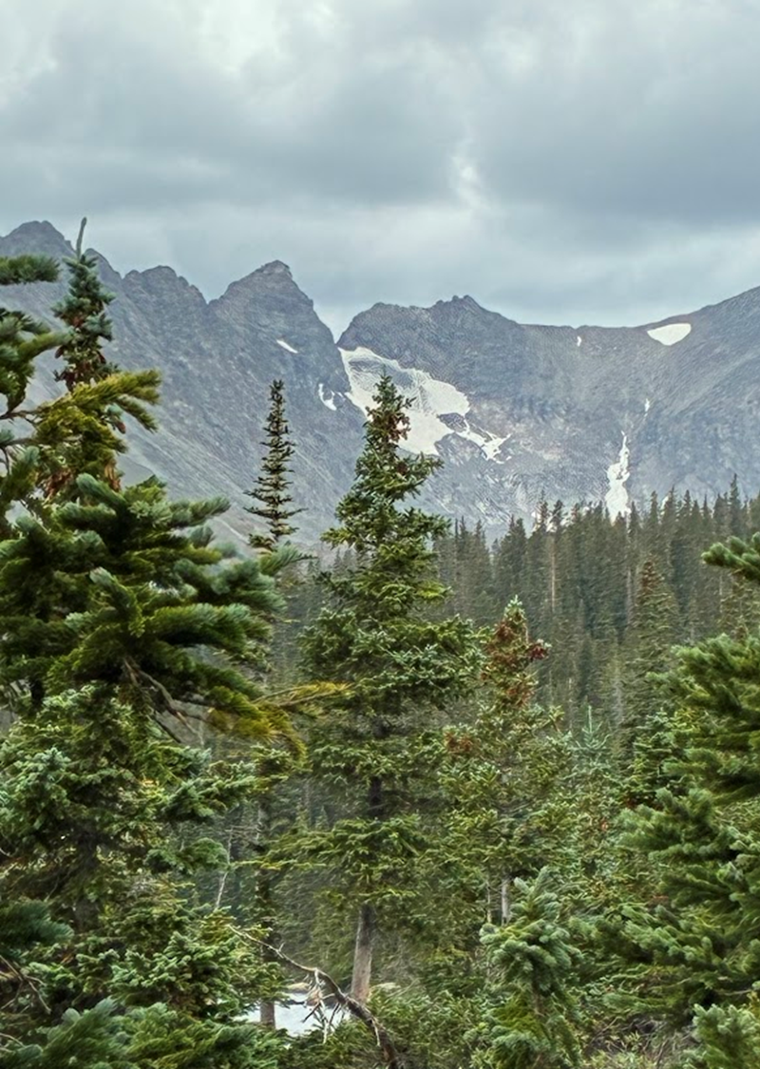
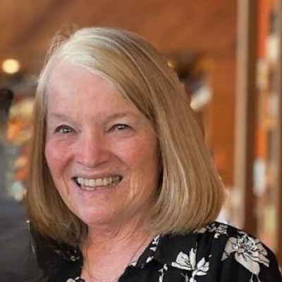
The Hero/ Heroine Archetype Journey to Emotional Wellness
Annabelle Nelson, PhD Professor
Fielding Graduate University, USA
Human and Organizational Development
Nelson, A. L. (2024).The heroine archetype Heroism Science: Vol. 9: Iss. 1, Article 9
Nelson, A. (2014). Archetypal imagery and the spiritual self. (2014) Singing Dragon
A special thanks to Dr. Chuk-Yim Stephen Chiang and his gift to the Rosenthal-Nelson-Appelbaum Fund

Slide 2

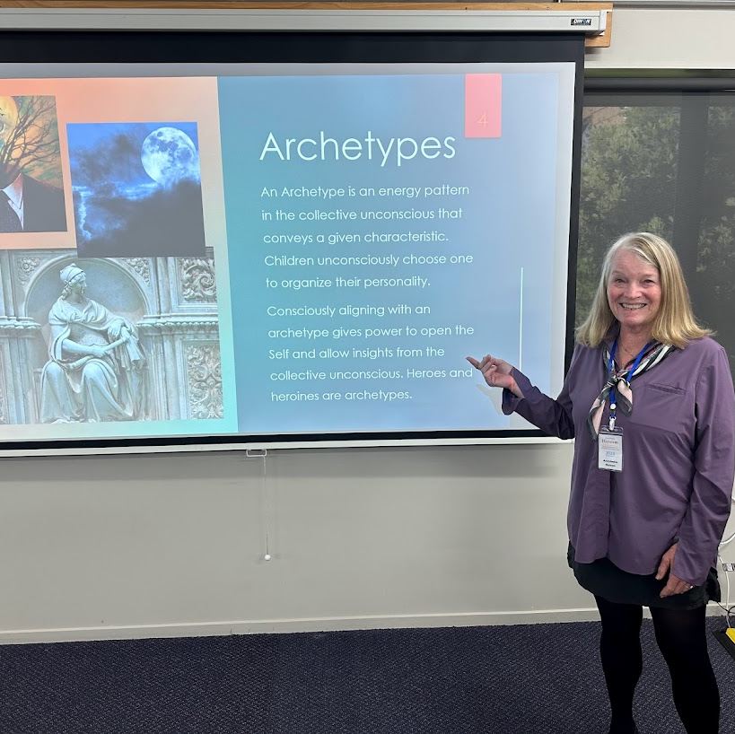
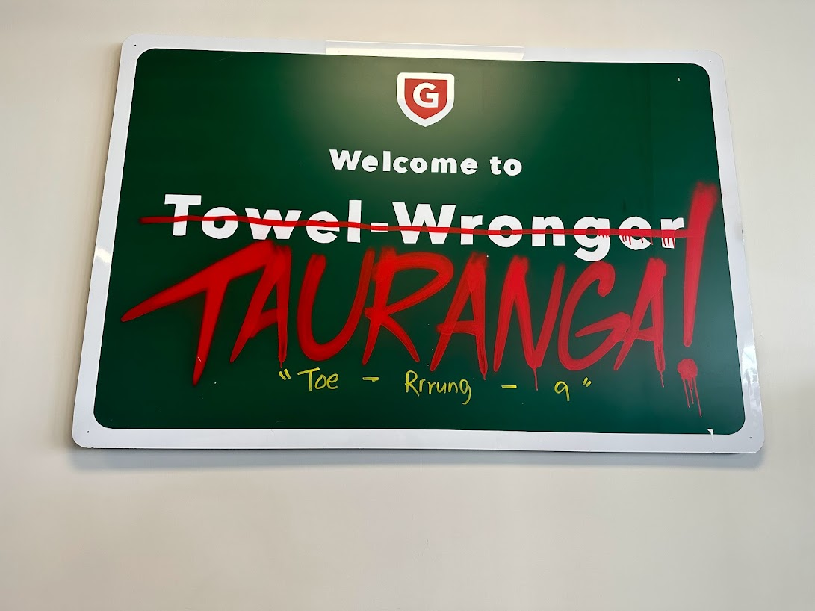
Heroism Science
2023
Tauranga, New Zealand
Thank you for the inspiration to do this research
Mount Maunganui Beach

Slide 3
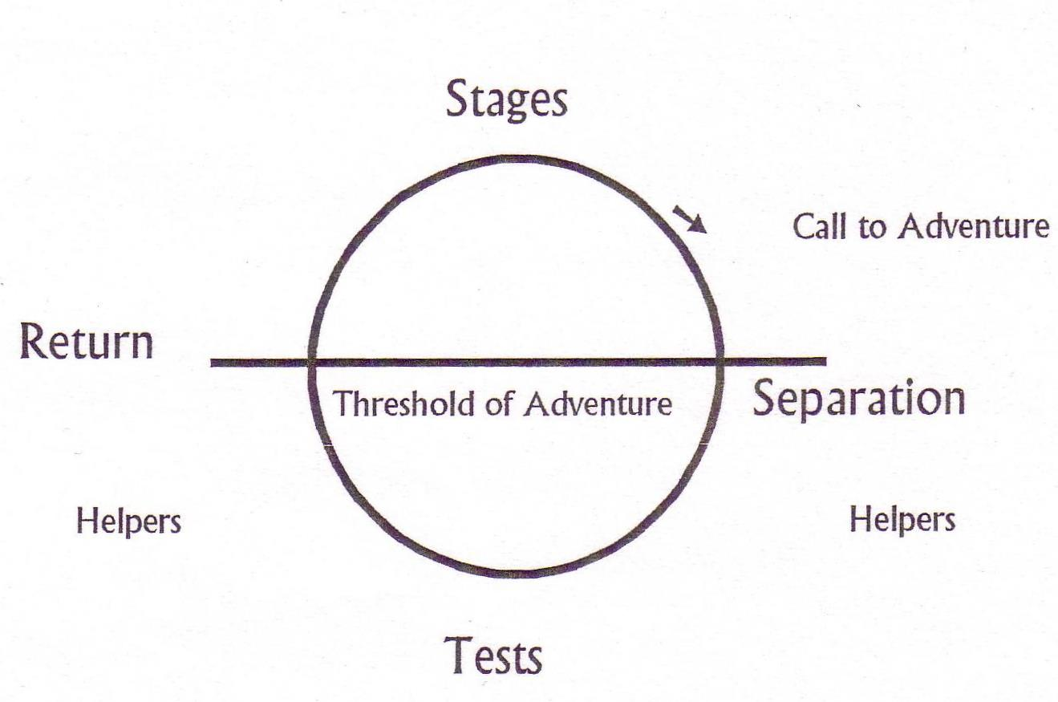
Trite, but powerful.
What if daily life is the call to adventure?
Buddha’s First Noble Truth: duhkka, suffering or dissatisfaction with life. Tests abound in life.
What if the Hero/Heroine journey is to face the tests of life to transform. To find the helpers. To return: “the adventurer must return with his life-transmuting trophy.” (Campbell pg. 196)
The Hero/Heroine Journey
The focus: tests & helpers

Slide 4
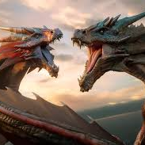
Tests in life:
Stress, Sadness, Relationships, stereotypes, External and Internal stories, Disappointments

Slide 5

Helpers:
Friends, families, Resources, ancest0rs, deities, INTERNAL, Mythic beings, animals, Internal CHARACTERIsticS

Slide 6
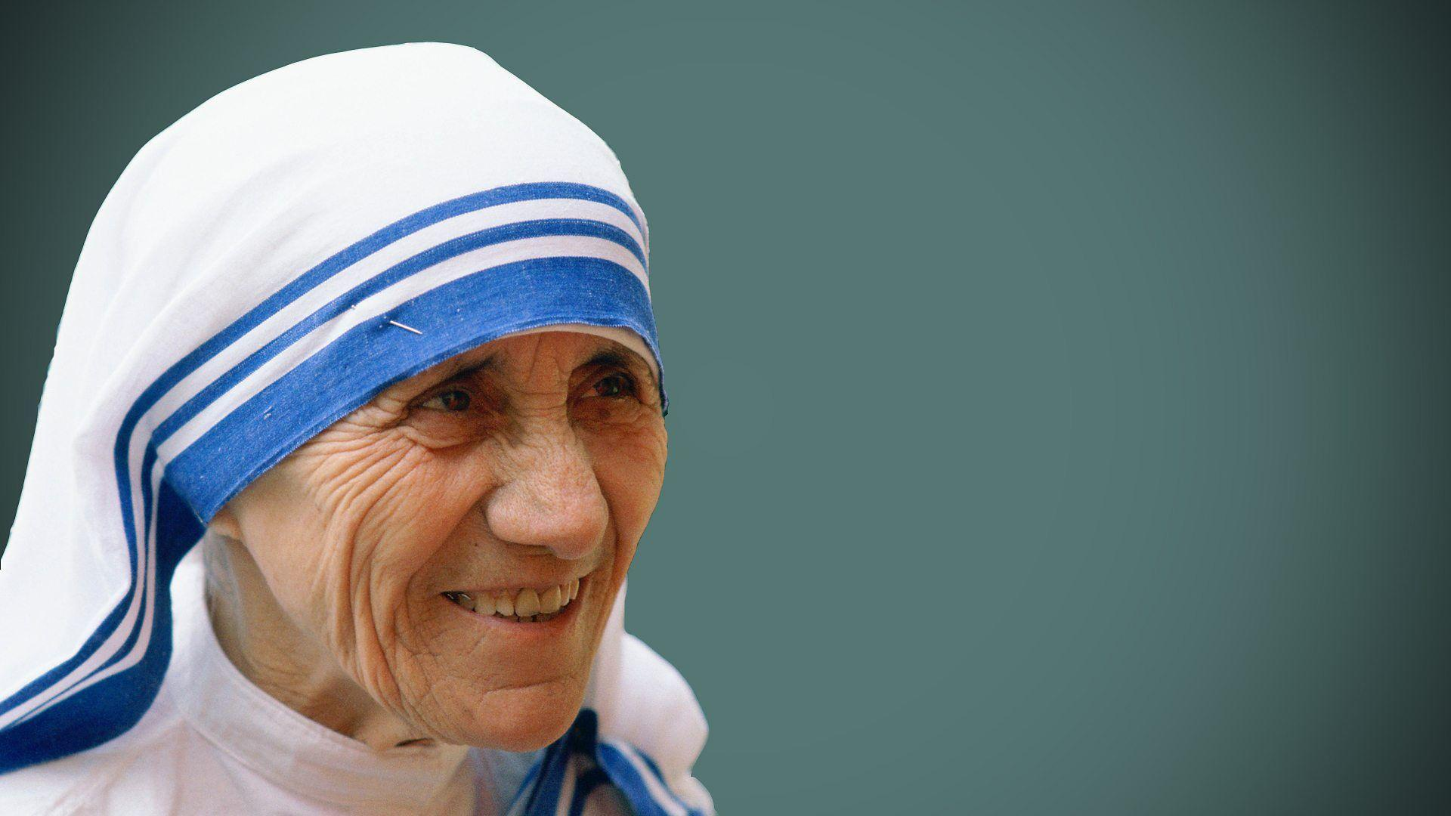
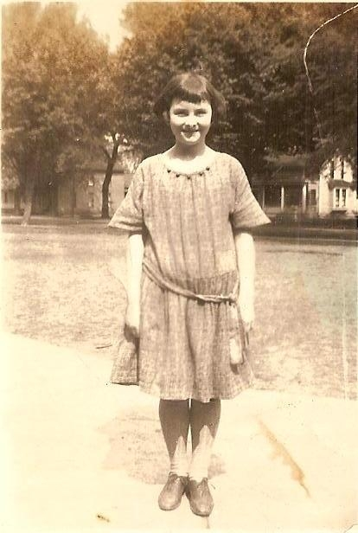
What if humans can find the capacity to be their own hero/heroine to face tests and find helpers? To find a characteristic of the hero/heroine to find the trophy of transformation.
Characteristics Of Hero/Heroines:
-vulnerability
-risk-taking & the ability to face tests
-moral commitment and altruism
-desire to help the community
-skills, cunning and crafts (Nelson, 2024)

Slide 7

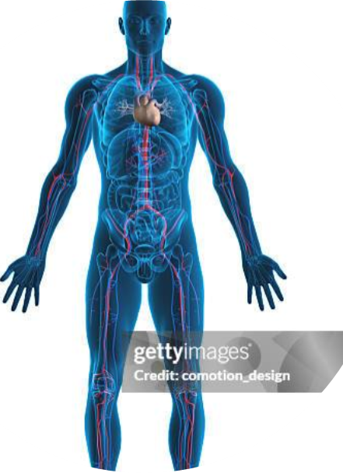




There is a natural psychodynamic of identification with archetypes that can be the helper to face tests to transform the inner world.
Archetypes activate a natural psychodynamic, an aperture to the personal and collective unconscious.
Children unconsciously choose one to organize their personality. Heroes, teachers, recluses, devas on the playground. Humans unconsciously live in front of an archetype. What if we consciously choose one?
Notes:
But we want human happiness as humans too

Slide 8
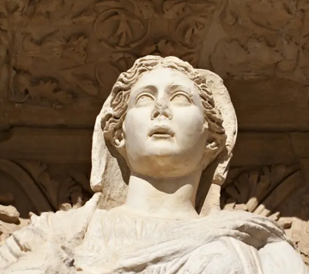
Archetypes
An Archetype is an energy pattern in the collective unconscious that conveys a given characteristic. Children unconsciously choose one to organize their personality.
Consciously aligning with an archetype gives power to open the Self and allow insights from the collective unconscious. Heroes and Heroines are archetypes. Adults can consciously choose one. Every Archetype contains Every other one (Marie-Louise von Franz).

Slide 9

Archetypal Wellness Workshop
70- minute zoom meeting: dyad work multisensory imagery activities, accompanied by meditation music.
-Dyad, think back to your childhood favorite character, book, TV show, movie, person
-Imagery, a favorite outside spot, you are feeling okay, an entity comes to you, let the scene move, debrief first with drawing, then sharing
-Imagery, a recent scene that engendered a feeling that you didn’t like, that didn’t feel good, see it in present time like a movie, find a spot in the body where you feel the most, visualize the feeling
-Imagery, bring your archetype into the scene, let the scene move, debrief first with drawing then sharing

Slide 10
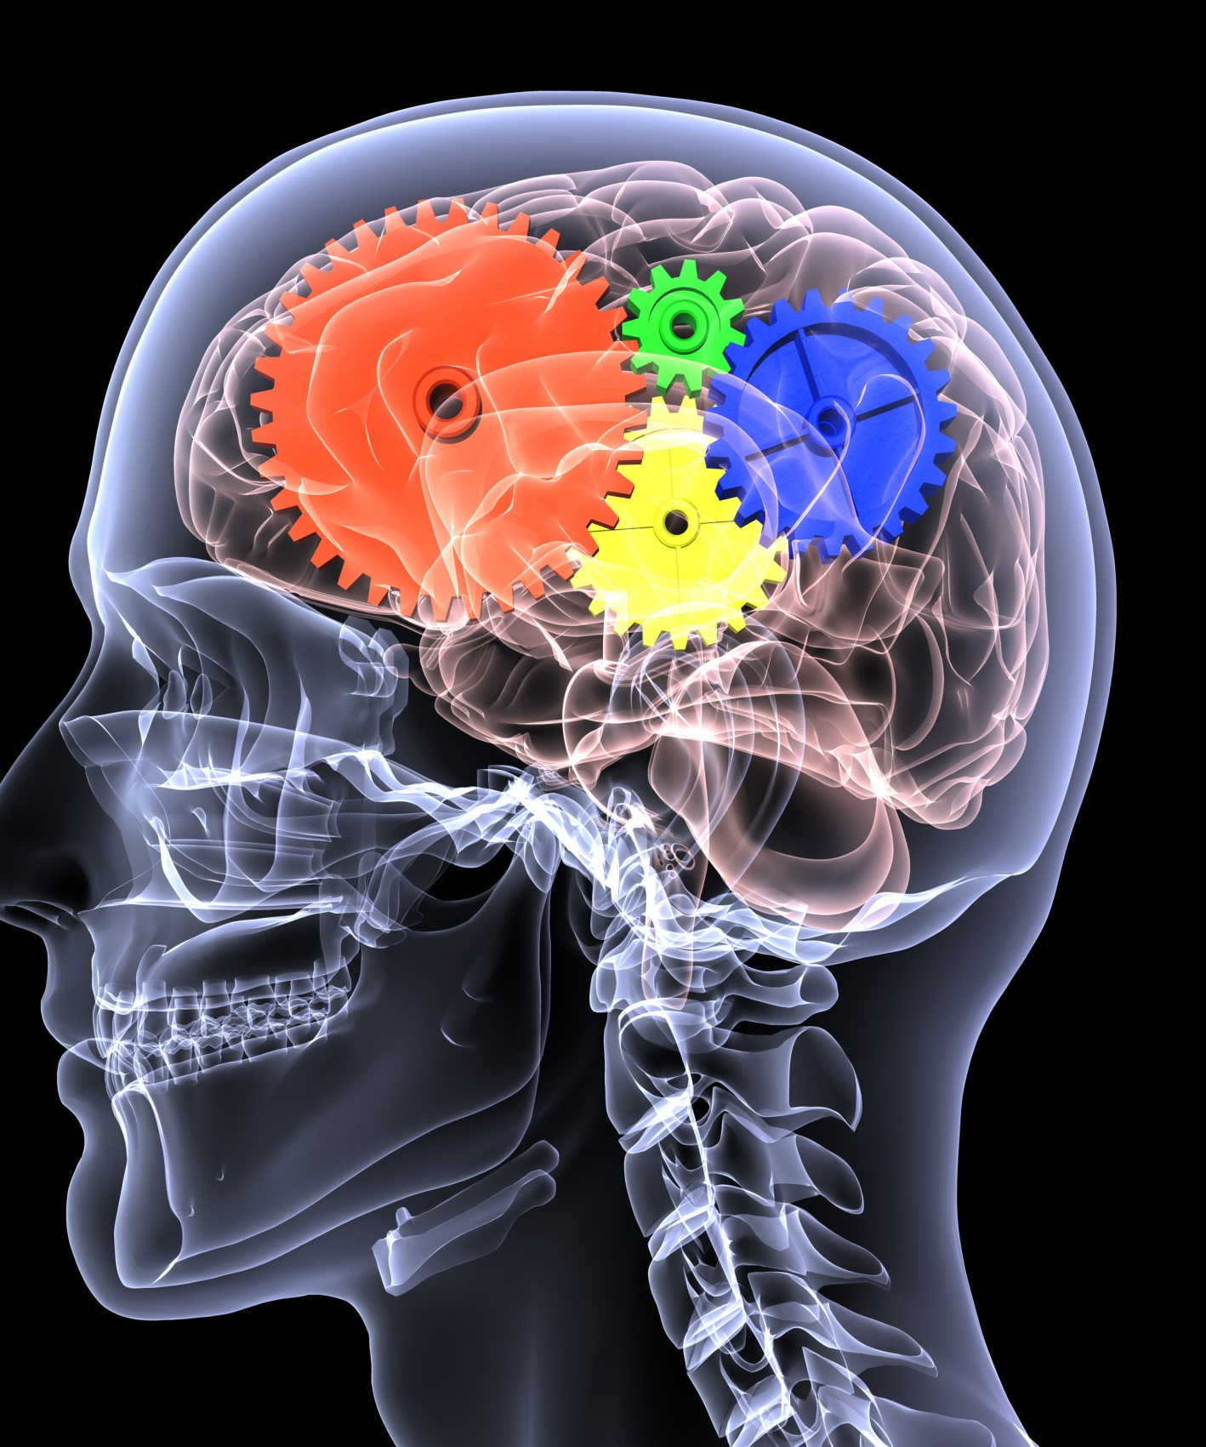
Data Collection (Qualtrics)
Pre: adapted Personal Assessment: Dimensions of Wellness, University of Colorado, (Emotional, Spiritual, Physical, Social, Occupational, Intellectual, Environmental). Likert and short answers. Example: I feel good about myself and believe others like me for who I am.
Post: Qualitative answers by the participants on the workshop experience and interaction with archetypes.
Follow-up: Qualitative answers on use of archetypes. & Personal Assessment: Dimensions of Wellness

Slide 11
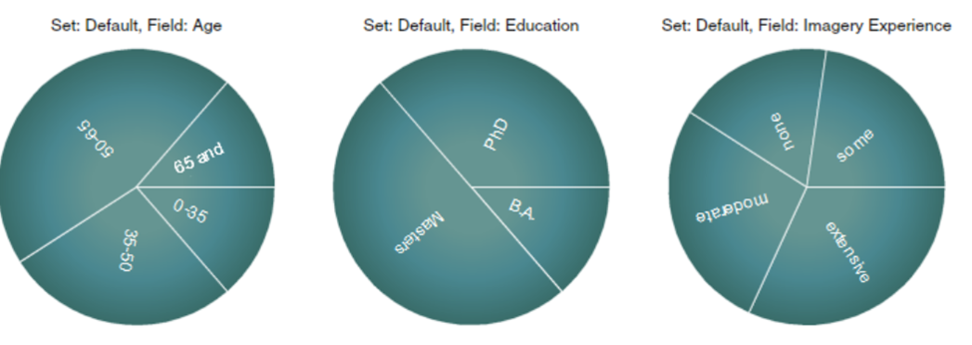
Participants,
22 from purposive sampling

Slide 12
Theme 1: Archetypes were easy to visualize
I didn’t realize that I had an archetype at all, let alone that it would be a source of inspiration and motivation. (937)
List of Archetypes Created by Participants: Muir Woods, Native American elder, Goofy, Barbie, Purple cloud-shape, feminine divine, floating being of white light, human form that sparkles, Viking, Batman, women riding a horse, butterfly, a brown hand, lion, Nordic forest deity, mermaid, rock band leader, Kuan Yin, jungle beach tree, wonder woman, humming bird, father, coyote

Slide 13
Themes 2: Awareness was enhanced
Calmness and peace
Openness to possibilities
Self- Empowerment
Refinement of Purpose
Keep focusing on the here and now, what’s right before me. (323)
Remain calm and focused while we prepare for the unknown (170)
My awareness became clear that perhaps by silencing myself, I may be doing more harm or causing more stress. (480)
My purpose and awareness that I was chosen to keep the family together(499)
I have a deeper awareness of the influence that I can bring to the outcomes of my situation (170)
I was able to see more possibilities about how to deal with the situation going forward, I might bring the idea in - it is now an option (711)
Brought me a sense of calm, allowing me to relax and trust that all is well.(279)

Slide 14
Theme 3: Interaction with archetype transmuted emotions
My Elder transmuted the painful emotion to one of well-being, and the color changed back to a vibrant orange color. I have increased awareness of my own well-being and forces that support my well-being. I will more likely work with my Elder to support my well-being in situations here I might experience lack or fear. (229)
When I saw the Native American /Indian I felt peace/calmness.(937)
The emotions subsided and completely evaporated. I felt calm and collected. Even protected (271)
I fill my life with the joy of people and experiences, or I can wallow in grief. (521)

Slide 15
Theme 4: Archetypes were called on for stress and difficult or messy situations (after 30 days)
I might summon my archetype when I feel stressed (247)
I certainly can see using this as a practice in the future to help me move from a difficult situation to one of more calm and perspective (785)
I can harness this image of embodying the archetype and expand beyond the fear the next time I am in a triggered state (266)

Slide 16
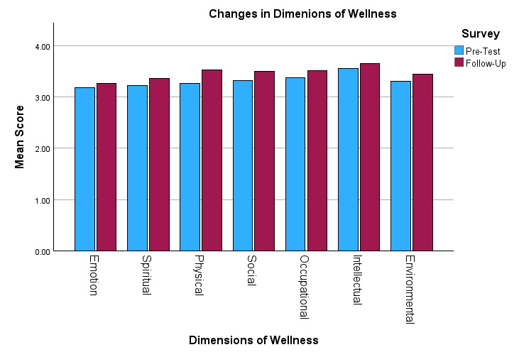
Paired Samples Correlations
 |  | N | Correlation | Significance
 |  |  |  | One-Sided p | Two-Sided p
Pair 2 | Pre_Spiritual & FU_Spiritual | 19 | .682 | <.001 | .001
Pair 6 | Pre_Intellectual & FU_Intellectual | 19 | .575 | .005 | .010
Spiritual Ex.:I take time to think about what is important in life - who I am, what I value, where I fit in, where I'm going
Intellectual Ex: I am open to new ideas.

Slide 17
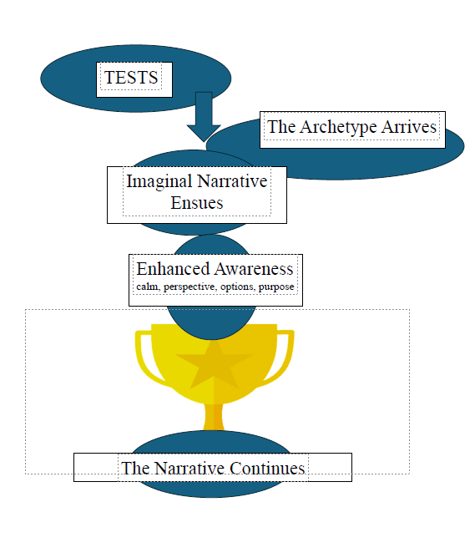
Archetypal
Wellness

Slide 18
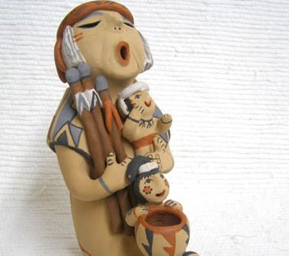
Thank you! Let’s keep telling our stories
Annabelle Nelson, PhD anelson@fielding.edu

Slide 19
Bibliography
Edinger, E.F. (2017). Ego and archetype. Shambhala Publications.
Fleischer, K. (2023). Collective trauma, implicit memories, the body, and active
imagination in Jungian analysis . Journal of Analytical Psychology, 68(2), 395-415.
Nelson, A. L. (2024). The Heroine Archetype. Heroism Science, 9(1), 9.
Nelson, A. (2014). Archetypal imagery and the spiritual self: Techniques for coaches and
therapists. Singing Dragon.
Ravitz, L. J. (2022). The valiant battle: from chaos to integration. Journal of Analytical
Psychology, 67(4), 1091-1125. https://doi.org/10.1111/1468-5922.12856
Steel, C., Wright, K., Goodwin, G. M., Simon, J., Morant, N., Taylor, R. S., ... & Holmes, E. A. (2023) The IBER study: a feasibility randomised controlled trial of imagery based
emotion regulation for the treatment of anxiety in bipolar disorder. International Journal
of Bipolar Disorders, 11(1), 27.
Von Franz, M. L. (2021). Volume 1 of the Collected Works of Marie-Louise von Franz: Archetypal
Symbols in Fairytales: The Profane and Magical Worlds. Chiron Publications.
Zaleskiewicz, T., Traczyk, J., & Sobkow, A. (2023). Decision making and mental imagery: A
conceptual synthesis and new research directions. Journal of Cognitive Psychology,
35(5), 603-633.

